Slide 1
Name : Swathi . S
Department : BSC , computer science Reg.no.: 24524u18099
NM id: EC240EB09D299E1A9B349D89B08D3BF9
College : Karan arts and science college

Slide 2

INTRODUCTION TO WEB DEVELOPMENT
HTML, CSS, and
JavaScript
Presented by Swathi.S

Slide 3
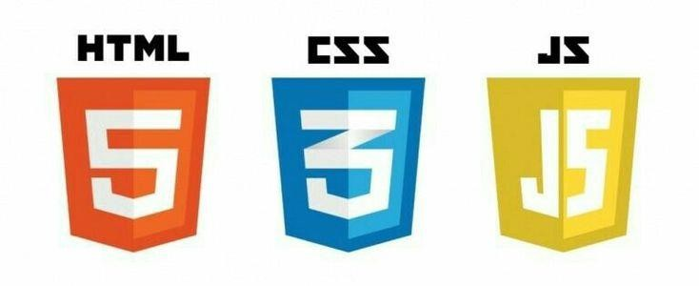
INTRODUCTION TO WEB DEVELOPMENT
Web development means building and maintaining websites.
It uses three main technologies: HTML, CSS, JavaScript.
HTML provides the structure of a webpage.
CSS adds style and design.
JavaScript makes the interactive and dynamic page

Slide 4

HTML BASICS
HTML = HyperText Markup Language.
It is the backbone of web pages.
Defines structure and content of a webpage.
Uses tags like <p>, <h1>,
<img>, <a>, etc.

Slide 5
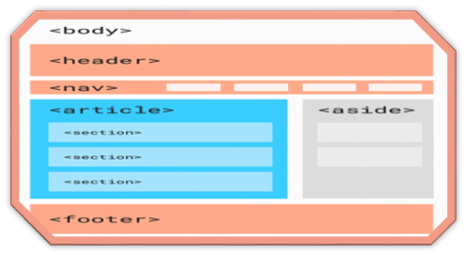
HTML STRUCTURE
A basic HTML page starts with
<!DOCTYPE html>.
<head> contains page info like title.
<body> contains the visible
content.
<!DOCTYPE html>
<html>
<head>
<title>My First Page</title>
</head>
<body>
<h1>Hello World!</h1>
<p>This is a
paragraph.</p>
</body>
</html>

Slide 6


HTML FEATURES & ADVANTAGES
Simple and easy to learn
Supported by all web browsers.
Organizes and structures content on webpages.
Basis for adding CSS (style) and JavaScript (interactivity).
Forms the foundation of every website.

Slide 7
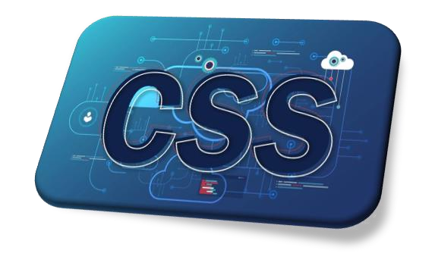
CSS INTRODUCTION
CSS = Cascading Style Sheets.
Adds design and style to HTML pages.
Controls colors, fonts, layouts, and spacing.
Separates content (HTML) from presentation (CSS).
Makes websites attractive and user-friendly.

Slide 8
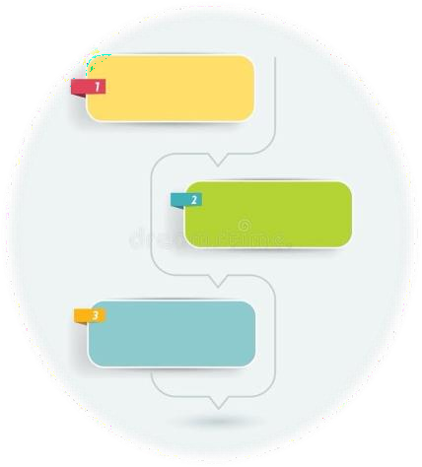
TYPES OF CSS
Inline CSS → Written inside an HTML tag.
Internal CSS → Written inside the <style> tag in the
<head>.
External CSS → Written in a separate .css file and linked to HTML.

Slide 9
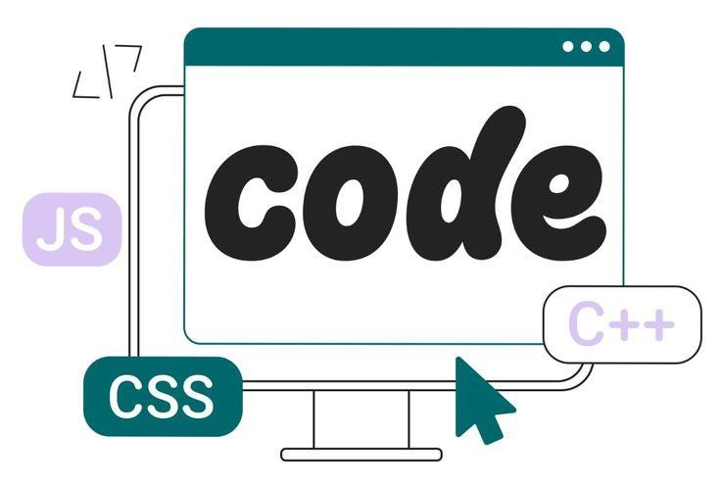
CSS EXAMPLE
h1 {
color: blue;
text-align: center;
}
p {
font-size: 18px;
font-family:
Arial;
}
CSS makes text colorful and attractive.
Ensures consistent design across all pages.
Styles can be reused multiple times

Slide 10

JAVASCRIPT INTRODUCTION
JavaScript is the programming language of the web.
Makes web pages interactive and dynamic.
Runs directly in web browsers.
Can update and change both
HTML and CSS instantly.

Slide 11

JAVASCRIPT FEATURES
Lightweight and flexible language.
Supports object-oriented
programming.
Enables event-driven
programming (e.g., button clicks).
Works on both frontend (browser)
and backend (Node.js).

Slide 12

JAVASCRIPT EXAMPLE
document.getElementB yId("demo").innerHTM L = "Hello JavaScript!";
javascript
Copy code
function add(a, b) {
return a + b;
}
alert(add(5, 3));
Can change webpage content dynamically.
Supports functions and user interactions.

Slide 13

USES OF JAVASCRIPT
Validating forms (e.g., checking email input).
Creating animations and visual effects.
Building interactive maps and menus.
Powering modern web apps like Gmail, Facebook,
YouTube.

Slide 14

COMPARISON: HTML VS CSS VS JAVASCRIPT
Feature | HTML (Structure) | CSS (Style) | JavaScript (Interactivity)
Purpose | Defines content | Adds design | Makes pages dynamic
Example | <h1>Hello</h1> | color:blue; | alert("Hi");
Role | Skeleton | Skin | Brain

Slide 15

REAL-TIME APPLICATIONS OF HTML, CSS, AND JAVASCRIPT
E-commerce websites (Amazon, Flipkart).
Social media platforms (Facebook,
Instagram).
Online forms, quizzes, and surveys.
Interactive dashboards and data visualization.
Modern web apps (React, Angular, Vue).

Slide 16

CONCLUSION:
HTML → Provides structure.
CSS → Adds style and design.
JAVASCRIPT → Brings interactivity.
TOGETHER, they form the foundation of
modern web development.

